Slide 1
Object-Oriented Programming

Slide 2
Objectives
Explain about OOP
Explain classes and objects
Define and describe methods
Explain about the access modifiers
Define and describe inheritance
Explain about method overriding
Explain about polymorphism and abstraction

Slide 3
Objectives
Discuss more new features in OOP :
Properties, Auto-implemented properties
Static class and Extension Method
Anonymous Type and Default contructor
Readonly members and Default interface methods
Using declarations
Expression-bodied members
Record type
Object Initialize
Read-only auto-properties and Init-Only Properties

Slide 4
Object-Oriented Programming(OOP)
Programming languages are based on two fundamental concepts: data and ways to manipulate data. This approach had several drawbacks such as lack of re-use and lack of maintainability
To overcome these difficulties, OOP was introduced, which focused on data rather than the ways to manipulate data
The object-oriented approach defines objects as entities having a defined set of values and a defined set of operations that can be performed on these values
Abstraction, encapsulation, polymorphism, and inheritance are the core principles of object-oriented programming

Slide 5
OOP Paradigm
Procedure-Oriented Program
Class A
{
}
data1
Modifiers
data1
data2
Function1 ()
Function1 (data1)
Function2 ()
Function2 (data1)
Function3 (data2)
Function4 (data2)
Class B
{
}
Object = Data + Methods
data2
Modifiers
Function3 ()
Basic Concepts
Encapsulation
Inheritance
Polymorphism
Particular methods:
Constructors
Function4()

Slide 6
Object-Oriented Programming
OOP is a powerful concept that solves many problems found in software development. OOP is not the holy grail of programming but it can help in writing code that is easy to read, easy to maintain, easy to update, and easy to expand
An object can inherit the properties of another object using the concept of inheritance. Hence, we can say that object-oriented programming is organized around data and the operations that are permitted on the data
When we do object-oriented programming, we start with identifying the entities we need to operate on, how they relate to each other, and how they interact. This is a process called data modeling and the result of this is a set of classes that generalize the identified entities

Slide 7
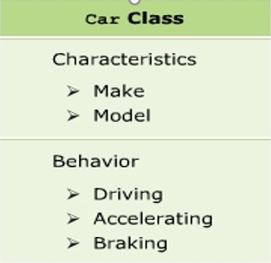

Classes and Objects
A class is a user-defined blueprint or prototype from which objects are created. Basically, a class combines the fields and methods (member function which defines actions) into a single unit

Slide 8
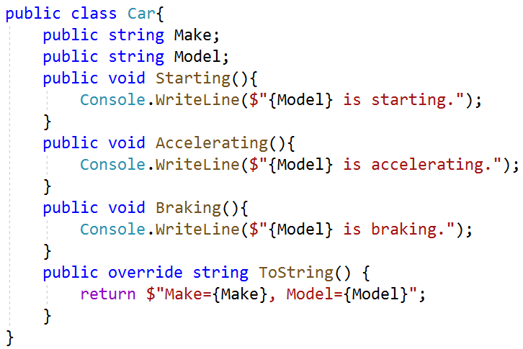
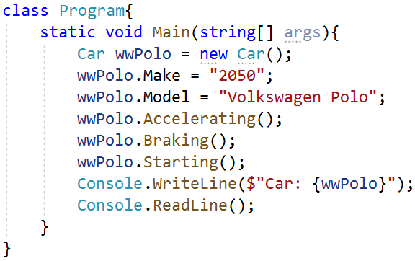
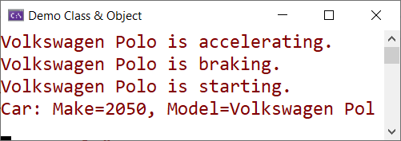
Classes and Objects
An object is an instance of the class and represents a real-life entity. To initialize an object in C#, we use a new keyword followed by the name of the class that the object will be based on

Slide 9
Member Visibility
There are five access specifiers: private, public, protected, internal, and protected internal. By default, the members are private to the class
public: The type or member can be accessed by any other code in the same assembly or another assembly that references it
private: The type or member can be accessed only by code in the same class or struct
protected: The type or member can be accessed only by code in the same class, or in a class that is derived from that class

Slide 10
Member Visibility
internal: The type or member can be accessed by any code in the same assembly, but not from another assembly
protected internal: The type or member can be accessed by any code in the assembly in which it's declared, or from within a derived class in another assembly
private protected: The type or member can be accessed only within its declaring assembly, by code in the same class or in a type that is derived from that class

Slide 11
OOP-Encapsulation
Encapsulation is defined as binding data and code that manipulates it together in a single unit
Data is privately bound within a class without direct access from the outside of the class
All objects that need to read or modify the data of an object should do it through the public methods that a class provides
This characteristic is called data hiding and makes code less error-prone by defining a limited number of entry points to an object’s data

Slide 12
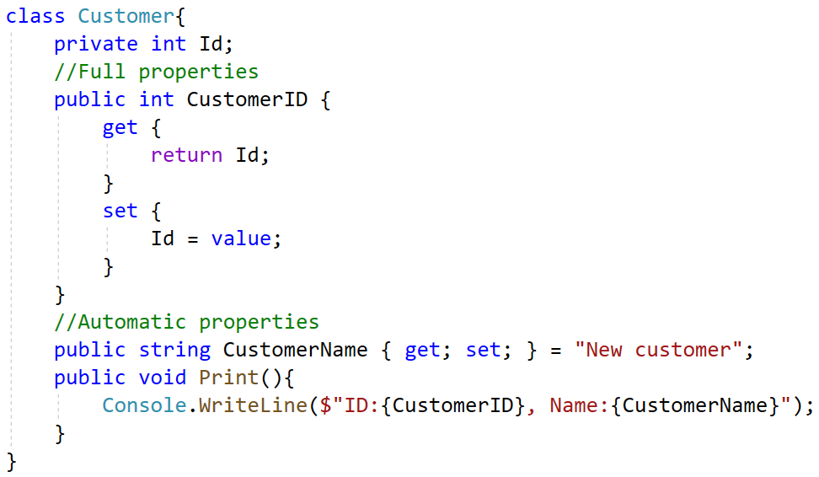
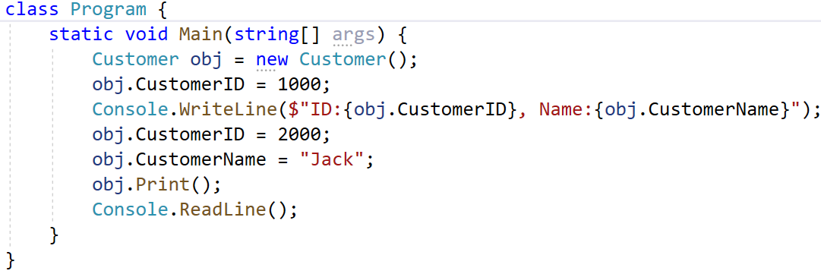

OOP-Encapsulation

Slide 13
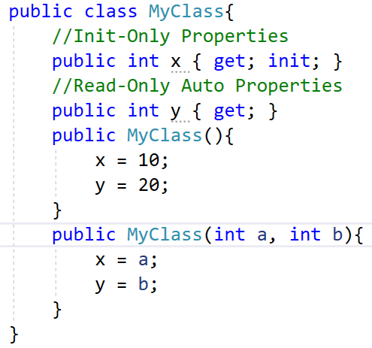
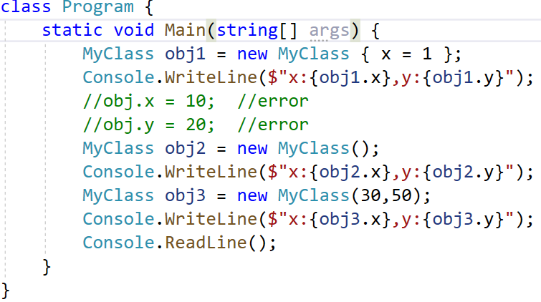
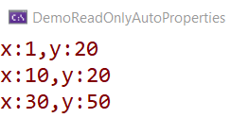
Read-only auto properties & Init-Only properties
When we write a property only with "get", it automatically becomes a Read Only property or we can use Init-Only properties
Notes:
https://docs.microsoft.com/en-us/dotnet/csharp/programming-guide/classes-and-structs/destructors

Slide 14
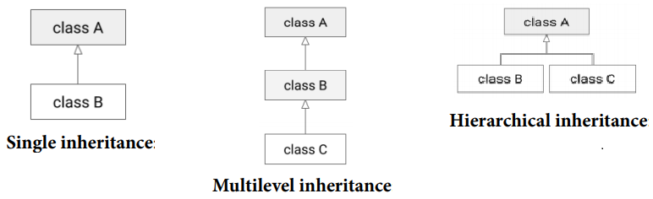
OOP-Inheritance
Inheritance is a mechanism through which a class can inherit the properties and functionalities of another class
Other classes can inherit these functionalities and data of the parent class as well as extending or modifying them and adding additional functionalities and properties.
There are three types of inheritance supported in C#:

Slide 15
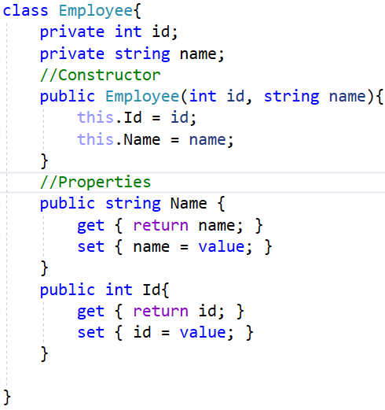
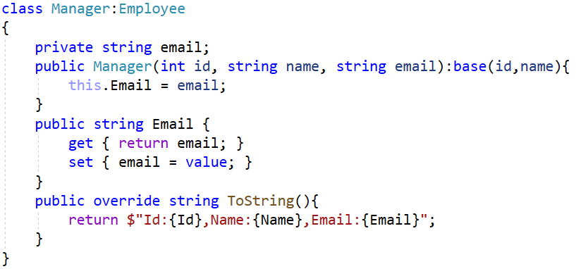
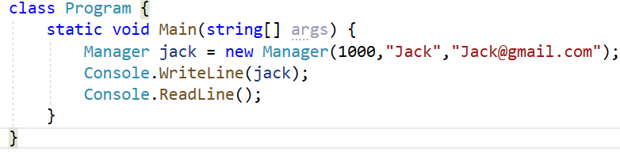

OOP-Inheritance

Slide 16
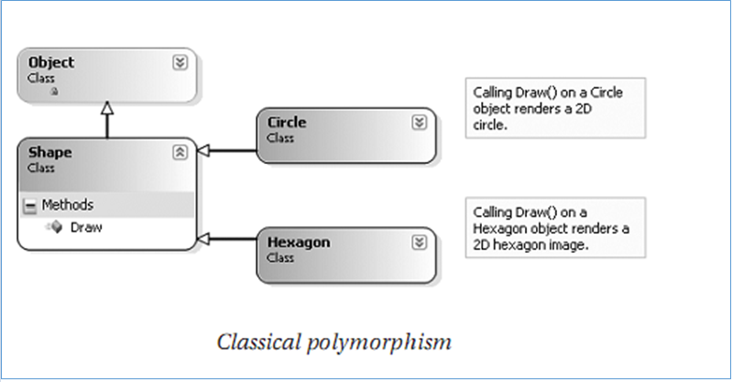
OOP-Polymorphism
Ability allows many versions of a method based on overloading and overriding methods techniques

Slide 17
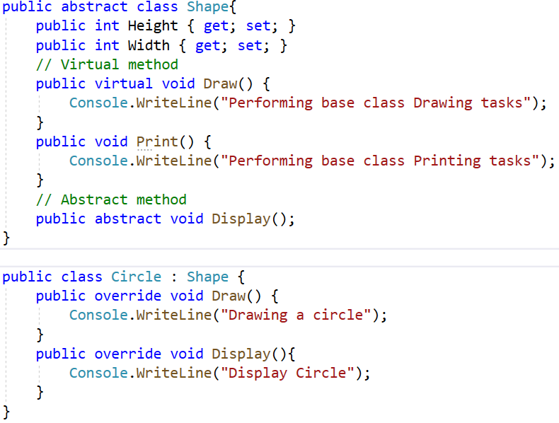
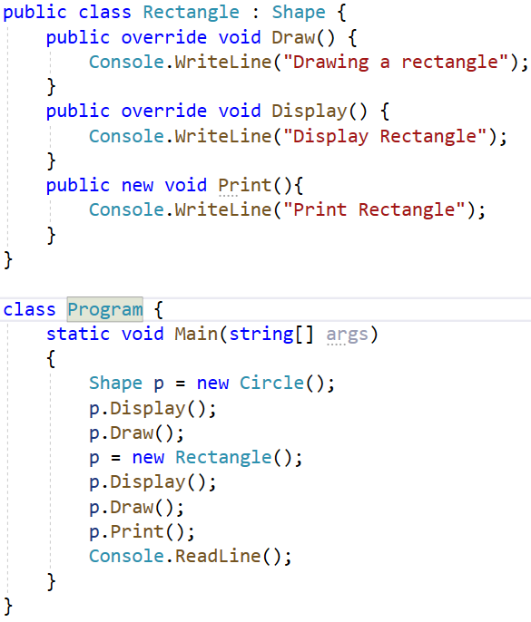
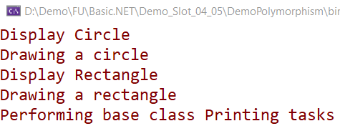
virtual : provide a default implementation. Can be overridden if necessary
abstract: sub-classes MUST override

Slide 18
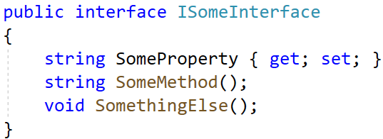
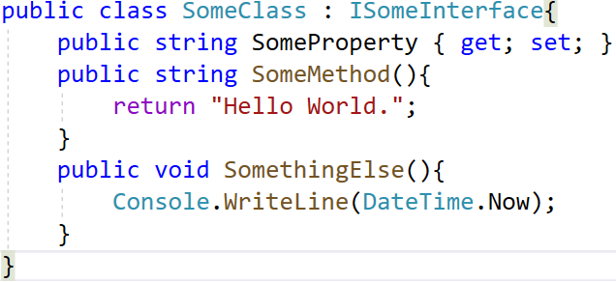
OOP-Interface
An interface contains definitions for a group of related functionalities that a class or a struct must implement
An interface cannot be instantiated but can only be inherited by classes or other interfaces
An interface may not declare instance data such as fields, auto-implemented properties, or property-like events. Interface names begin with a capital “I”

Slide 19
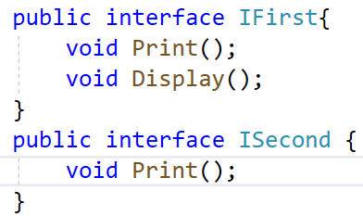
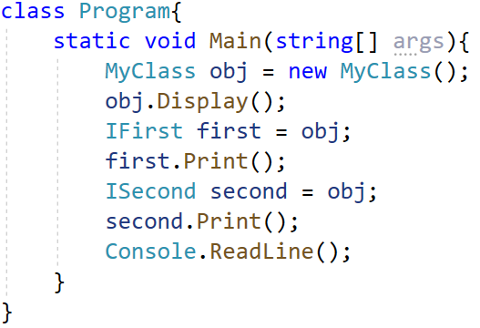
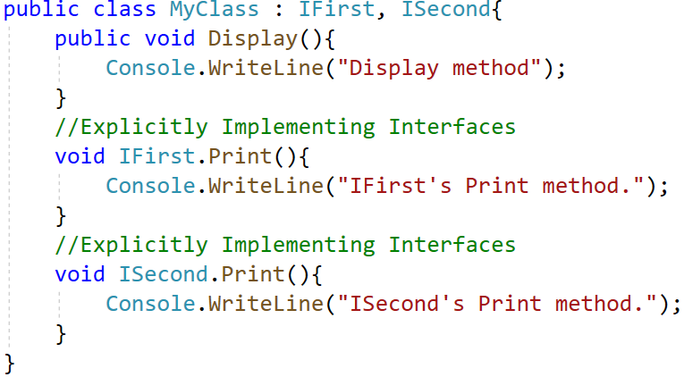
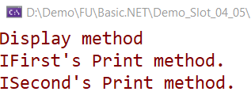
OOP-Interface

Slide 20
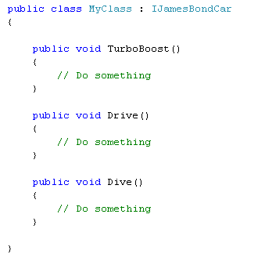
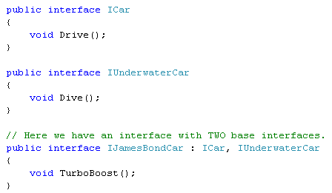
Interface Inheritance

Slide 21
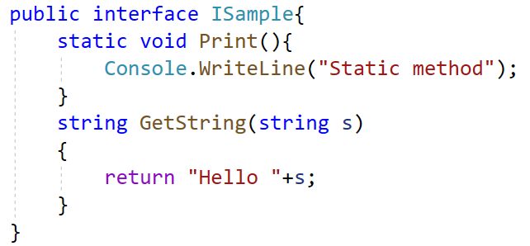
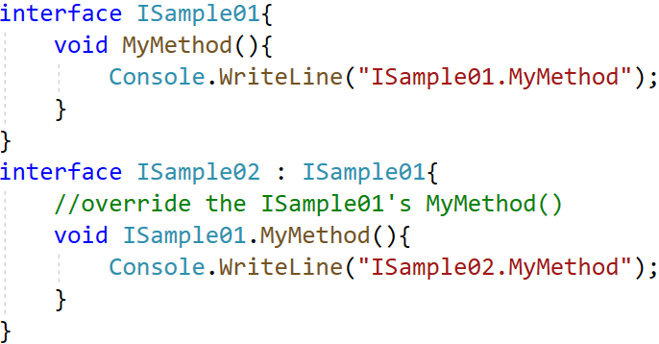
Default Interface Methods
C# allows to add a method with their implementation to the interface without breaking the existing implementation of the interface, such type of methods is known as default interface methods (virtual extension methods)

Slide 22
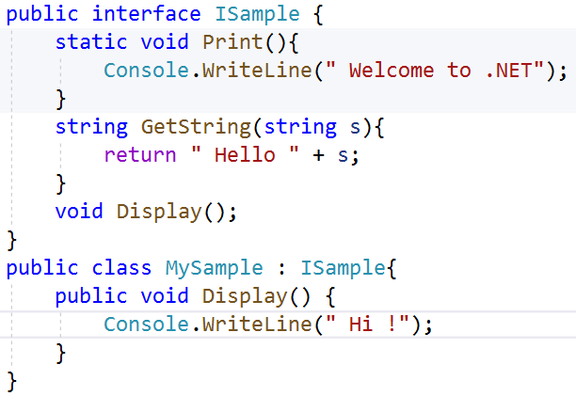
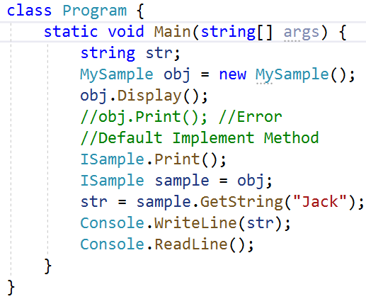
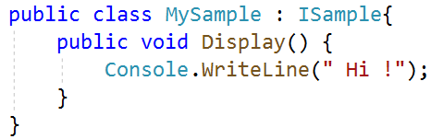
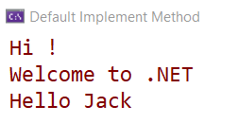
Default Interface Methods

Slide 23
The is and as Operators
The is operator is used to check if the run-time type of an object is compatible with the given type or not whereas as operator is used to perform conversion between compatible reference types or Nullable types
The is operator returns true if the given object is of the same type whereas as operator returns the object when they are compatible with the given type
The is operator returns false if the given object is not of the same type whereas as operator return null if the conversion is not possible
The is operator is used for only reference, boxing, and unboxing conversions whereas as operator is used only for nullable, reference and boxing conversions

Slide 24
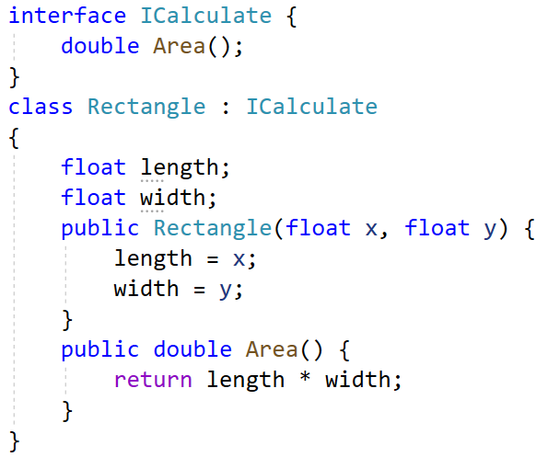
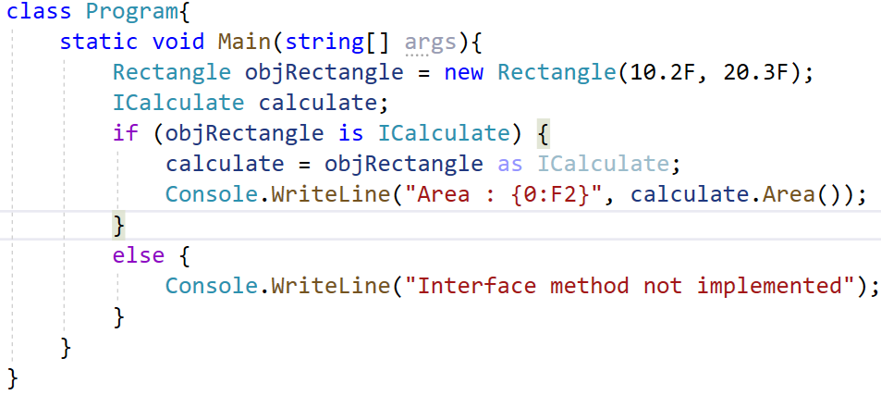

The is and as Operators

Slide 25
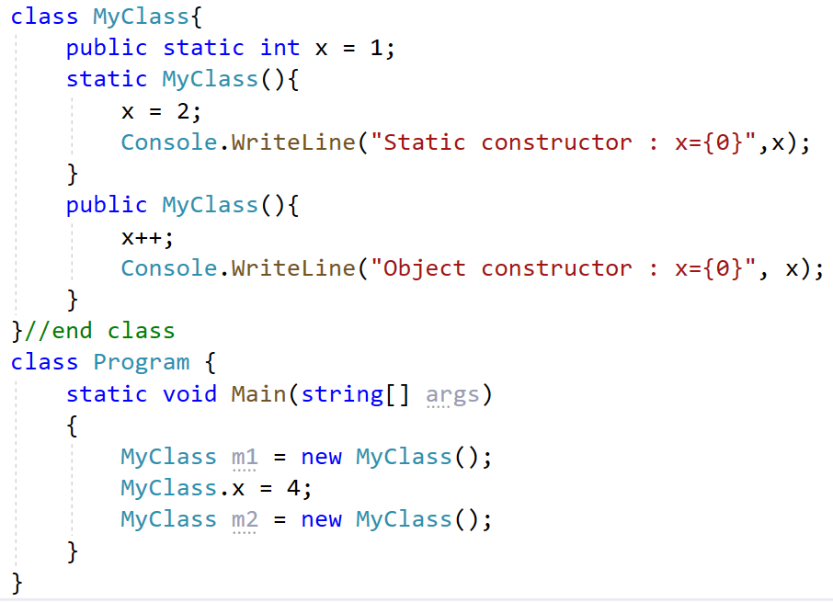
Static Constructor
Prevent static field to be reset
A given class (or structure) may define only a single static constructor
A static constructor executes exactly one time, regardless of how many objects of the type are created
A static constructor does not take an access modifier and cannot take any parameters
The static constructor executes before any instance-level constructors

Slide 26
Static Class
Classes that cannot be instantiated or inherited are known as classes and the static keyword is used before the class name that consists of static data members and static methods
It is not possible to create an instance of a static class using the new keyword. The main features of static classes are as follows:
They can only contain static members
They cannot be instantiated or inherited and cannot contain instance constructors However, the developer can create static constructors to initialize the static members

Slide 27
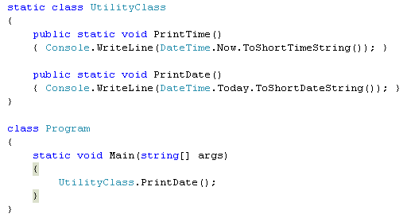
Static Class
No instance created

Slide 28
Extension Method
Extension methods allow us to extend an existing type with new functionality without directly modifying those types
Extension methods are static methods that have to be declared in a static class
We can declare an extension method by specifying the first parameter with the this keyword
The first parameter in this method identifies the type of objects in which the method can be called
The object that we use to invoke the method is automatically passed as the first parameter

Slide 29
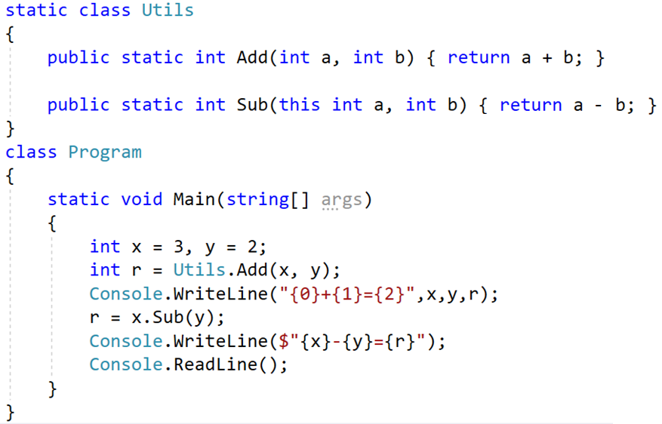
Extension Method

Slide 30
Expression-bodied Members
Expression body definitions let us provide a member's implementation in a very concise, readable form
We can use an expression body definition whenever the logic for any supported member, such as a method or property, consists of a single expression
An expression body definition has the following general syntax:
member => expression;
Members can be: Method, Read-only property, Property, Constructor, Finalizer (destructors) and Indexer

Slide 31
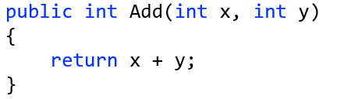
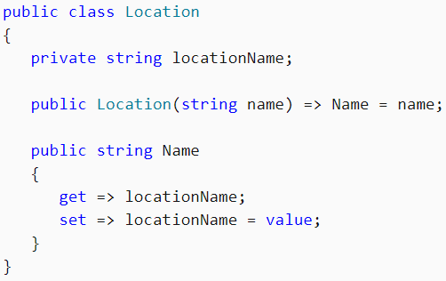
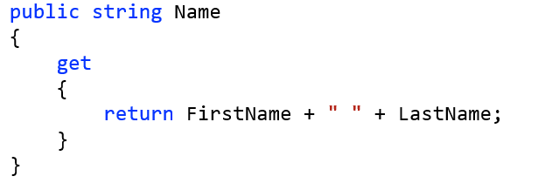
Expression-bodied Members

Slide 32
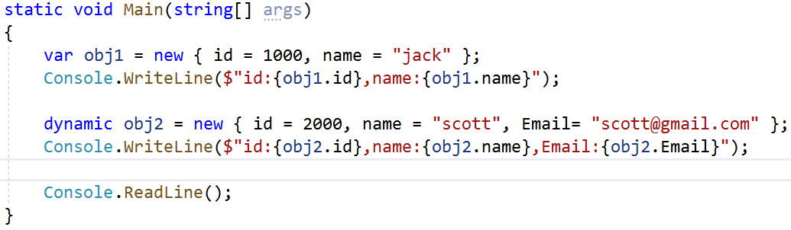
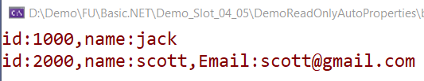
Anonymous Type
Is basically a class with no name and is not explicitly defined in code
Uses object initializers to initialize properties and fields. Since it has no name, we need to declare an implicitly typed variable to refer to it
Anonymous types are class types that derive directly from object, and that cannot be cast to any type except object

Slide 33
Object Initialize
Object initializers let we assign values to any accessible fields or properties of an object at creation time without having to invoke a constructor followed by lines of assignment statements
The object initializer syntax enables us to specify arguments for a constructor or omit the arguments
class Customer { public string Name { get; set; } public int Age { get; set; } }
Can be combined with any constructor call
Customer c = new Customer(); c.Name = "Jack"; c.Age = 20;
var c = new Customer(){ Name = "Jack", Age = 20};

Slide 34
Readonly Member and Const Keyword
In a field declaration, readonly indicates that assignment to the field can only occur as part of the declaration or in a constructor in the same class
A readonly field can't be assigned after the constructor exits
A const field can only be initialized at the declaration of the field(a compile-time constant)
A readonly field can be assigned multiple times in the field declaration and in any constructor(a run-time constants)

Slide 35
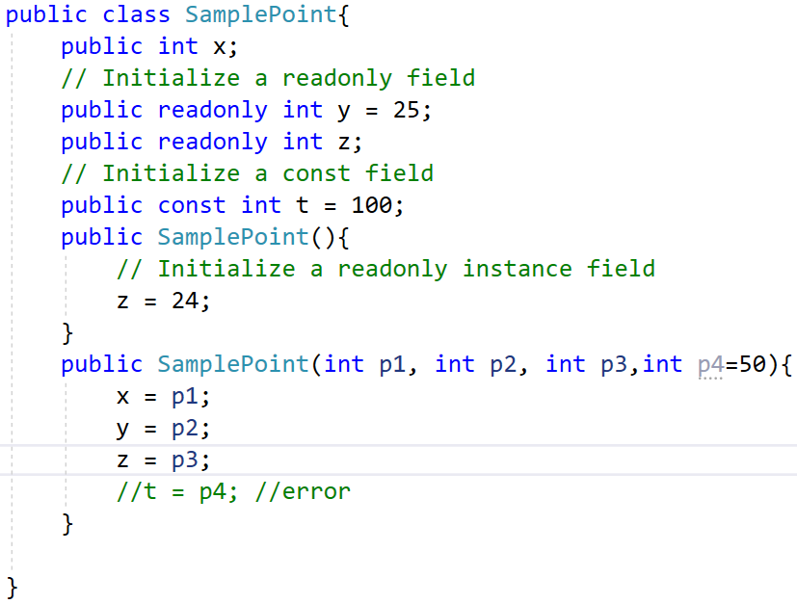
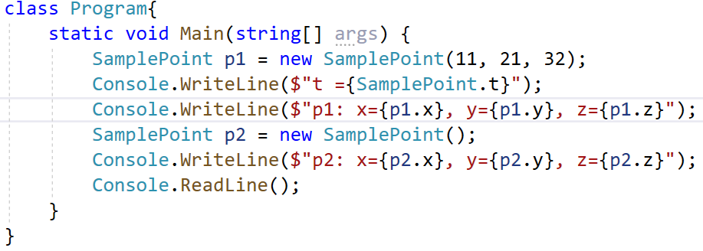
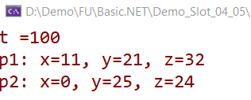
Readonly member and const keyword

Slide 36
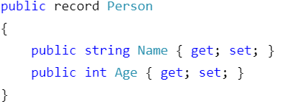
Record type
Records type is a new reference type that we can create instead of classes or structs
Records are distinct from classes in that record types use value-based equality
We define a record by declaring a type with the record keyword

Slide 37
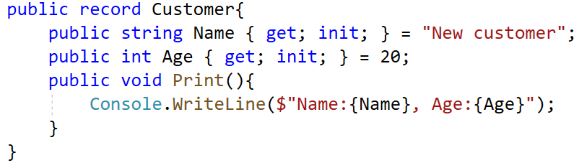
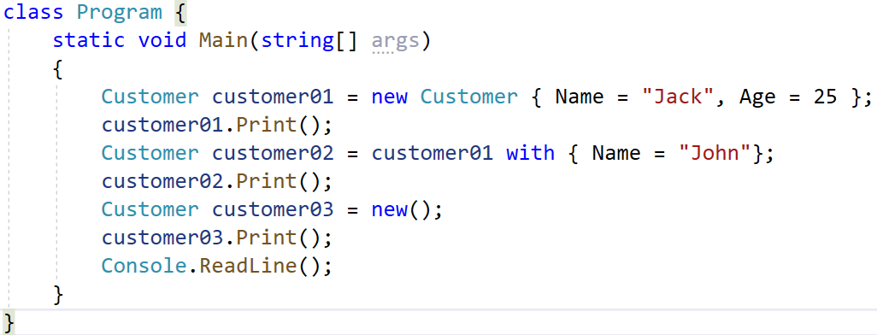
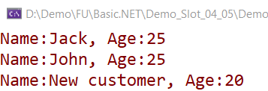
Record type

Slide 38
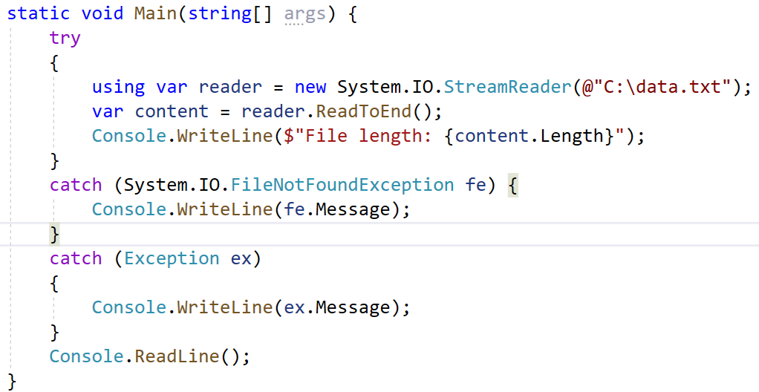
Using Declarations
With the using declaration, the objects are disposed automatically. Its scope is automatically defined from the object’s declaration statement to the end of the current code block

Slide 39
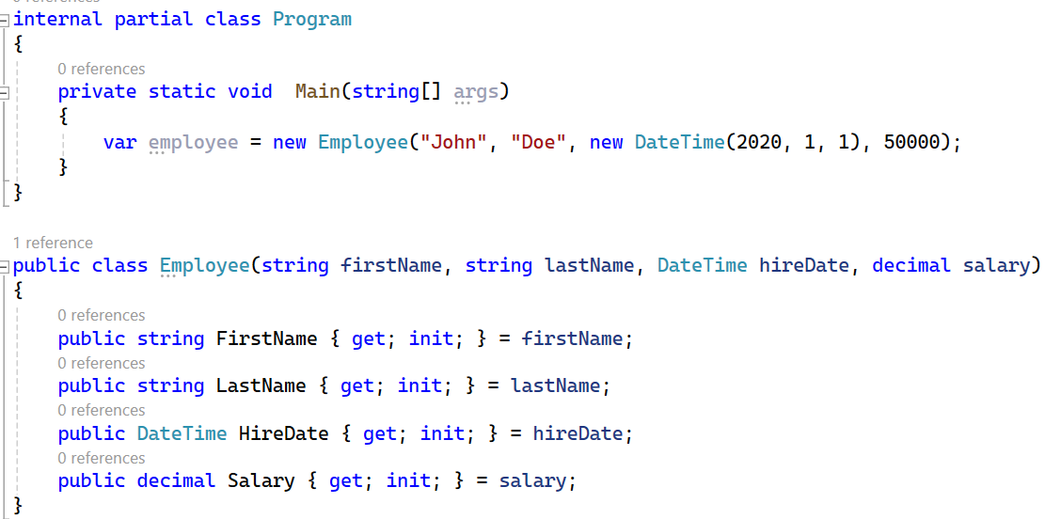
OOP with C# 11, C#12
Primary Constructors for Classes and Structs
This feature simplifies class and struct declarations by allowing you to define the constructor directly within the type declaration.
It eliminates the need for a separate constructor method, leading to more concise and readable code.

Slide 40

OOP with C# 11, C#12
Alias Any Type
C# 12 extends the ability to alias types beyond just namespaces. You can now create aliases for any type, including unnamed types like tuples.
This improves code readability and allows for concise references to complex types.

Slide 41

OOP with C# 11, C#12
Required Keyword (from C# 11 but relevant to OOP)
While introduced in C# 11, the required keyword is relevant to OOP as it enforces mandatory property and field initialization during object construction.
This helps prevent null reference exceptions and ensures object validity.

Slide 42
Summary
Explain about OOP
Explain classes and objects
Define and describe methods
Explain about the access modifiers
Explain method overriding
Define and describe inheritance
Explain about polymorphism
Explain about abstraction

Slide 43
Summary
Discuss more new features in OOP :
Properties, Auto-implemented properties
Static class and Extension Method
Anonymous Type and Default contructor
Readonly members and Default interface methods
Using declarations
Expression-bodied members
Record type
Object Initialize
Read-only auto-properties and Init-Only Properties

